Slide 1

O_TWO No.8 in Periodic table but No.1 for your existence.
Team Members
Priyanka, Kamatham –U01036286
Ani Siva Rama Krishna, Chelluboyina -U01027636
Sasi, Maddineni – U01016161
Surya Teja, Sunkavalli – U01032106
Target Markets: Patients Suffering from Covid-19 and other complications.
Value Propositions: No.8 in Periodic table but No.1 for your existence.

Slide 2
What is the PROBLEM?
Shortage of Oxygen cylinders during covid crisis.
Health systems are under extreme strain as a result of COVID-19, which has caused hospitals to run out of oxygen, causing avoidable fatalities and forcing families of hospitalized patients to pay more for limited oxygen supply.
No well-known website and application famous from which people can able to buy Oxygen as per the need.

Slide 3

Our SOLUTION
We are working on building a model that will be able to provide oxygen cylinders to everyone through online website.
A large variety of items on our website also implies a wide variety of pricing. Through the feedback or live chat, our team of customer service(admin) is here to assist you in locating what you need at a price that works for you.
People are using mobile devices at extended level, our web application helps people to get oxygen tanks.
Django framework, which is a technique in distributed computing is used for coding and development.
Social media platforms will also be used to gather information from relevant individuals that would help people who are in necessity of oxygen tanks.

Slide 4

Key Winning features & Capabilities
Use of AWS and Django framework to develop and implement the website.
The greatest standards of privacy, protection, and security are provided for your personal information on our oxygen tanks website.
Hosting of the website AWS that guarantees all all-time uptime.
The nicest aspect of purchasing an oxygen concentrator online, like with the rest of your online shopping, is being able to do it from the convenience of your own home.
Live chat option for Customers to get the immediate response on their queries.
A large variety of items on our website also implies a wide variety of pricing.

Slide 5


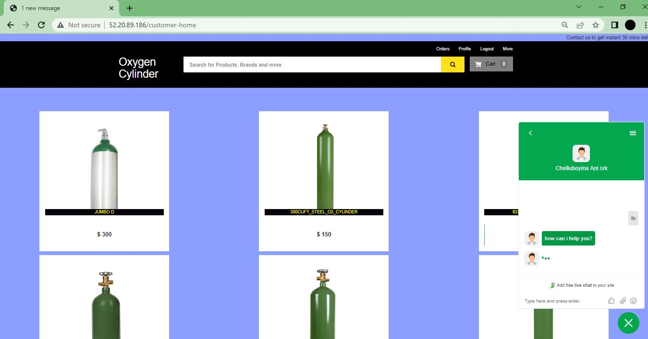
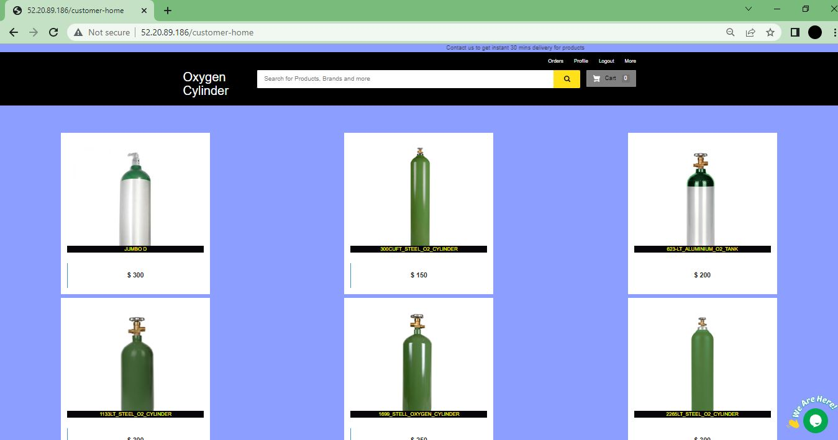
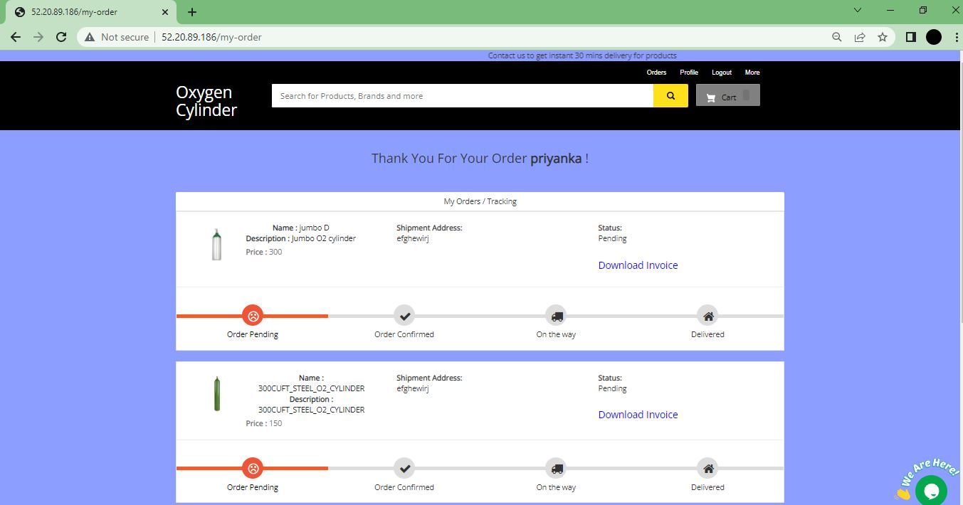
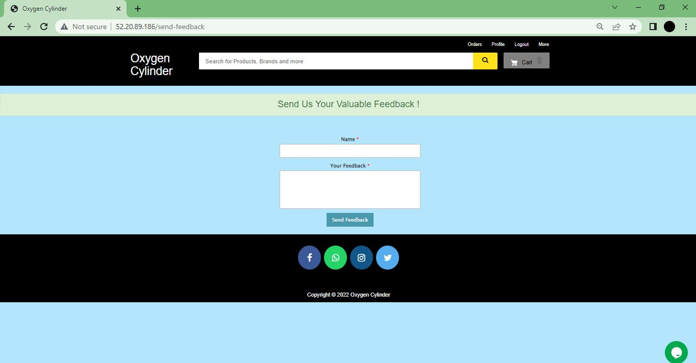
Key Features

Slide 6

Justification
We began by thinking about how important oxygen is to people and how everyone should have access to it in times of emergency. This website for online oxygen tank deliveries has been developed by us.
Our website now allows you to go through all of the best oxygen concentrator models and chat with a consultant without ever having to get in a car and drive to a store.
This website can be used by all groups of people (any patients and hospitals) which leads the higher rate of patient survival.
Our website is simple to use, trustworthy, reliable, and secure.
The website shall be able to notify the users when the item is in-stock.
An all-time available connectivity, therefore, the website can be found and used at any time.

Slide 7
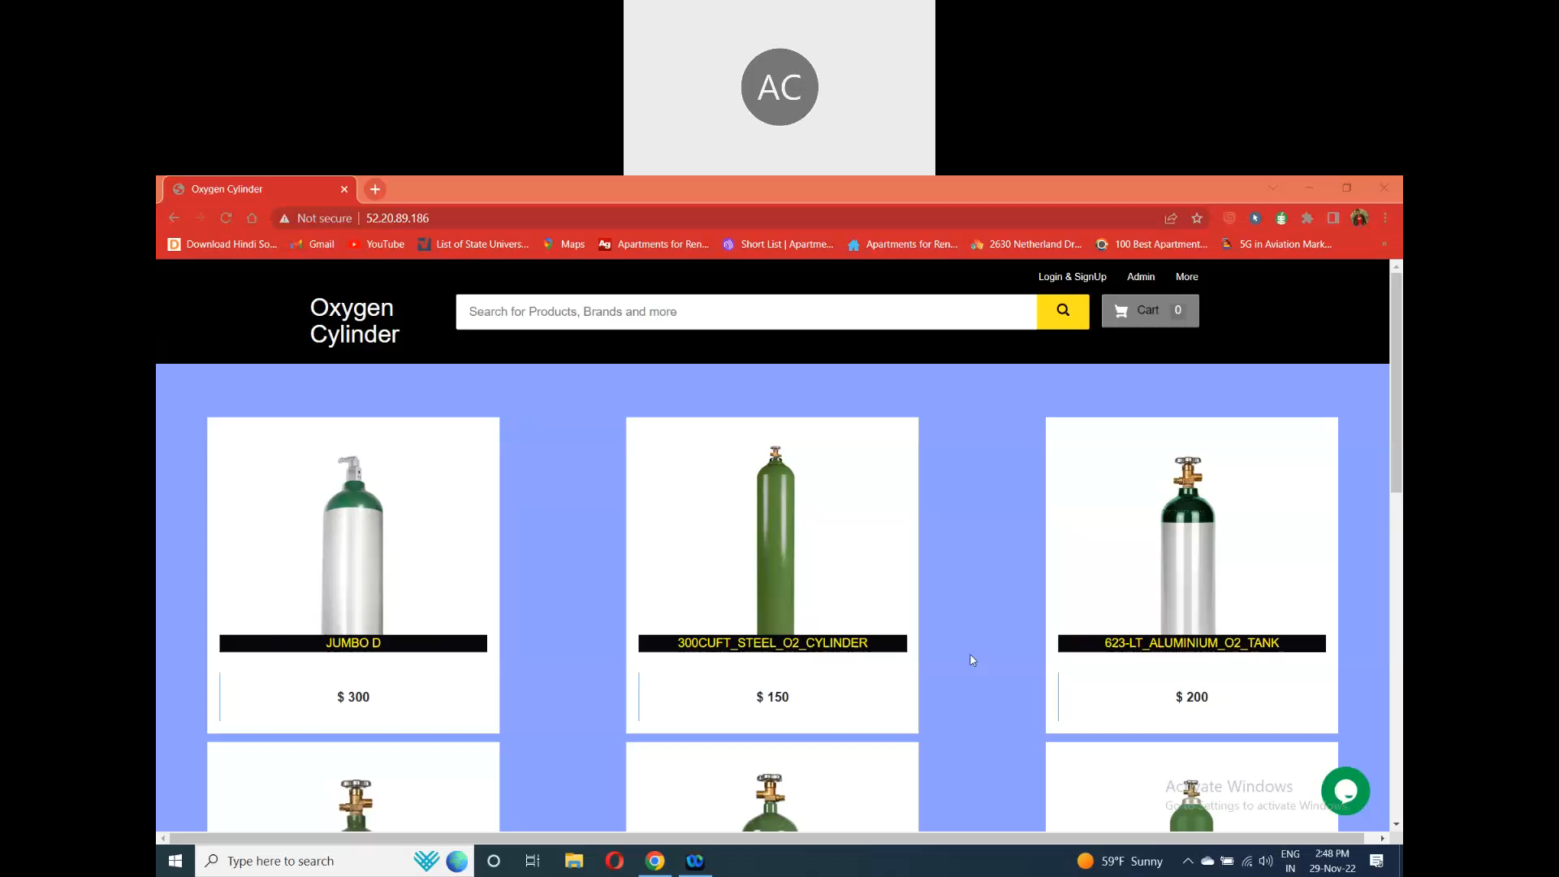
Initial prototype Current status
For people in emergency situations, such as COVID-19, a portable oxygen delivery system prototype model is planned to be developed in this project.
Our website helps and improves patients' quality of life and access to healthcare services by delivering oxygen tanks.
Live chat and online feedback are always available to continuously adapt the website to the needs of users.

Slide 8
Business Model
Key Partners | Value Proposition
All local medical centers. Health care investors. Patients | View the website through image based model. Multiple tank models and sizes available. No Commercials Continuous feedback/live chat.
Channels | Key Resources
Word of mouth. Any device. Use of all the available media platforms for marketing. | Our Customer Employees. AWS Django. Static images
How Do We Make Money?
Our strategy is to approach local health agencies and ask them to sign up with us so they may receive frequent information on new models for regular business. Offering incentives and maintaining connections with people like asthma sufferers and those with respiratory issues.

Slide 9
Team’s Contributions
Team Member | Contributions Made
Ani Siva Rama Krishna, Surya Teja | Development & Deployment
Priyanka Kamatham, Sasi Maddineni | Analyzing & classifying data collected

Slide 10
Plan for Implementation, Technical Validation, Market-Entry & Scaleup
The COVID-19 outbreak has increased the need for oxygen on a global scale and increased the urgency of oxygen supply. Our website for oxygen cylinders can be used to deliver oxygen tanks to patients.
Our website can help patients in need of oxygen as well as the needs of healthcare systems.
We have a live chat feature that assists clients in finding answers to their queries.
Our website was developed using the Django framework, Python, HTML, CSS, Bootstrap, MySQL, and AWS.
All patients, hospitals, and oxygen providers require this website as it increases the patient survival rates.
The global medical oxygen cylinder market size is 4 billion dollars in 2022. It is expected to grow 5.9 billion dollars by 2030 with a cagr of 4.9% . This include usage in all sectors like, hospitals, tourism & others. (source : https://www. grandviewresearch.com)
We want to introduce the prescription submission procedure in the future, enabling users to upload their prescription through our online portal. After it is uploaded, our customer service staff securely stores it and starts processing the order.

Slide 11


